Slide 1
SEC C LITERATURE & LONG READING
POEM 2 HOW TO TELL WILD ANIMALS
BY CAROLYN WELLS

Slide 2
ABOUT THE POET
Carolyn Wells (1862-1942) was an American writer who was famous for books based on mystery. Her famous works are at the sign of the Sphinx (1896), The Jingle book (1899), the story of Betty (1899) etc.

Slide 3
Poem Introduction
In the poem, the poet has explained the characteristics of various wild animals in a very funny way. She has used language in a way that it generates humour. She is introducing the reader to various kinds of wild animals like Asian lion, Bengal tiger, bear, etc. explaining each of the animals in a very humorous way

Slide 4
Summary of the poem
The poet is describing the various wild animals. These animals are very dangerous and she has introduced them one by one in a very funny way. First of all she tells us about an Asian lion. She says that if you are visiting the jungles of the east and there you see an animal which has tawny skin and he roars so loudly that you will die out of fear. This means that you have seen an Asian lion. Next in the line is the Bengal tiger that she has explained to be a royal animal that at once attacks and kills a man. She says by adding humour that if this beautiful black striped animal kills you and eats you, then you have surely met a Bengal tiger. After this, she says that if the reader met an animal that has black spotted skin and it at once jumps on him, then it means that the reader has met a leopard. Moreover, she says that if one will cry out in pain, it maybe of no use as the leopard will not stop attacking him. Then she moves on to the bear that she says will hug very tightly. This is the way to recognize a bear as it kills a person by hugging him very tightly.

Slide 5
So, she says that the bear will continue to hug us tightly and that is the only way to recognize him. After this, she asks a question to the readers that do they know how to recognize beasts that hunt their prey. Here she explains about hyenas which she thinks have a smiling face and the crocodiles that have tears in their eyes. This can be seen when they are killing their prey. The last one in the list is the Chameleon. She says that it is a lizard - like creature which doesn’t have ears and wings just like a lizard. Only this can help you differentiate between a lizard and chameleon. She further says that the chameleon has a quality of changing its color according to the colour of the surface. So, to explain this she says that if the reader looks at the tree and if he can only see the tree, this means that there is a chameleon sitting on it which has already turned its color

Slide 6
STANZA 1
The poet is telling the readers that how they can recognize various animals in the jungles of the east. So, in first stanza she says that if the reader comes across an animal whose skin is yellowish brown in colour and if it roars at him so strongly that he can die out of fear, it means that he has encountered an Asian Lion. She has humorously explained the Asian Lion which could kill a person with its roar.
Literary Devices
Rhyme: Rhyme scheme ababcc is followed (chance-advance, east-beast, dyin-lion) Enjambment: Continuation of a sentence to the next line (and if there…..tawny beast) Inversion: Change in the format of a sentence (if there should to you advance) Assonance: use of vowel sound ’o’ (you should go, should to you, roars,) Allusion: Reference to a famous thing, place, species of animal, etc (Asian Lion)

Slide 7

STANZA 2
She explains an animal that roams in the jungle and belongs to a royal clan. The colour of its skin is yellowish with black stripes. She says that if you notice that he kills you and eats you up, then this means that you have surely seen a Bengal Tiger. This time also she has used dark humour to explain how a tiger looks like because once a person has been eaten up by a wild animal, there is no use in determining which wild animal it is.
Literary Devices
Rhyme: Rhyme scheme ababcc is followed (round-ground, you-you learn-discern) Alliteration: repetition of consonant sound ‘r’ at start of two or more closely connected words (roaming round) Inversion: Change in the format of a sentence (The Bengal Tiger to discern) Allusion: Reference to a famous thing, place, species of animal, etc (Bengal Tiger) Assonance: Use of vowel sound ’o’ (or if some time when roaming round

Slide 8
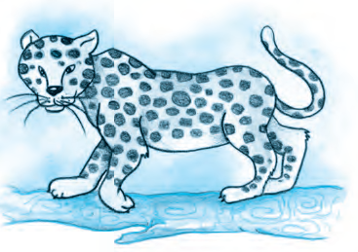
STANZA 3
The poet says that if you are casually walking in a jungle, you will meet an animal who has a skin with spots on it. This animal is so fast that it will leap on you at once which means that it will jump on you. This jumping is an indication that it is none other than the Leopard. Moreover, she adds that if you will cry out in pain, it is not going to be of any use as it will keep on jumping on you. So, in this stanza the poet has explained the characteristic of a leopard.
Literary Devices
Rhyme: Rhyme scheme ababcc is followed (view- you, peppered- Leopard, pain-again) Alliteration: use of consonant sound ‘h’ in the beginning of two words (he has) Poetic license: A liberty to the poet to change the spellings in order to create rhyme or rhythm in a poem (use of lept instead of leapt) Repetition: use of ‘lep’ word in the last line. Assonance: use of vowel sound ‘o’ (strolling-forth-you, whose-spot, do no good to roar)
Consonance: use of ‘l’ sound (he’ll only lep lep)

Slide 9
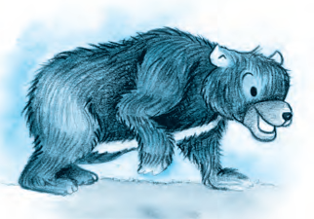
STANZA 4
If you are walking in the lawn area of your house and you meet a creature which hugs you tightly, it is a bear. She further adds that if you are still in doubt regarding the animal, the easiest way is that he will keep hugging and touching you very gently. This act of his will make you sure about its identity. You will come to know that it is a bear.
Literary Devices
Rhyme: Rhyme scheme ababcc is followed (yard-hard, there- bear, guess-caress) Enjambment: Continuation of a sentence to the next line (if you were walking….creature there) Alliteration: use of ‘w’ sound (when-walking), use of ‘h’ sound (who- hugs), use of ‘b’ sound (be-bear) Assonance: use of vowel ‘e’ (meet a creature there)

Slide 10
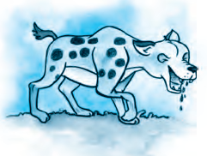
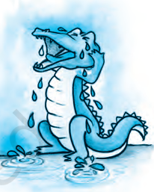
STANZA 5
The poet says that for someone who is new to the job of recognizing animals, it will be like a puzzle to recognize animals that hunt other animals for their food. So here the poet tries to help out the readers by telling the difference between two animals. He says that Hyenas will be smiling whereas if it is a crocodile, it is always in tears. Both of these animals are dangerous.
Literary Devices
Rhyme: Rhyme scheme ababcc is followed (prey-may, nonplus-thus, smiles-crocodiles) Alliteration: use of consonant sound ‘n’ (novice-nonplus), use of ‘th’ sound (the-thus)
Enjambment: continuation of sentence to the next line (though to distinguish….might nonplus, The crocodile…..hyena thus)

Slide 11
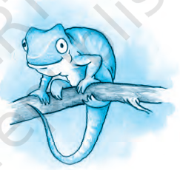
STANZA 6
The poet says that the next is Chameleon which is a small creature. It looks like a lizard but the difference between the two is that chameleon does not have ears and wings. Moreover she says that chameleon has the ability to change its color according to the surface on which it is sitting. Therefore, if you see a tree and find nothing else on it, then it must be a chameleon sitting on it. It has changed its colour into the color of tree.
Literary Devices
Rhyme: Rhyme scheme ababcc is followed (small-all, thing-wing, tree-see) Alliteration: use of ‘h’ sound (he hasn’t) Consonance: use of ‘g’ sound (single wing)

